Slide 1


December 10, 2025
Extended Diff: Line Mapping Across Two Files
Meet The Team

Slide 2



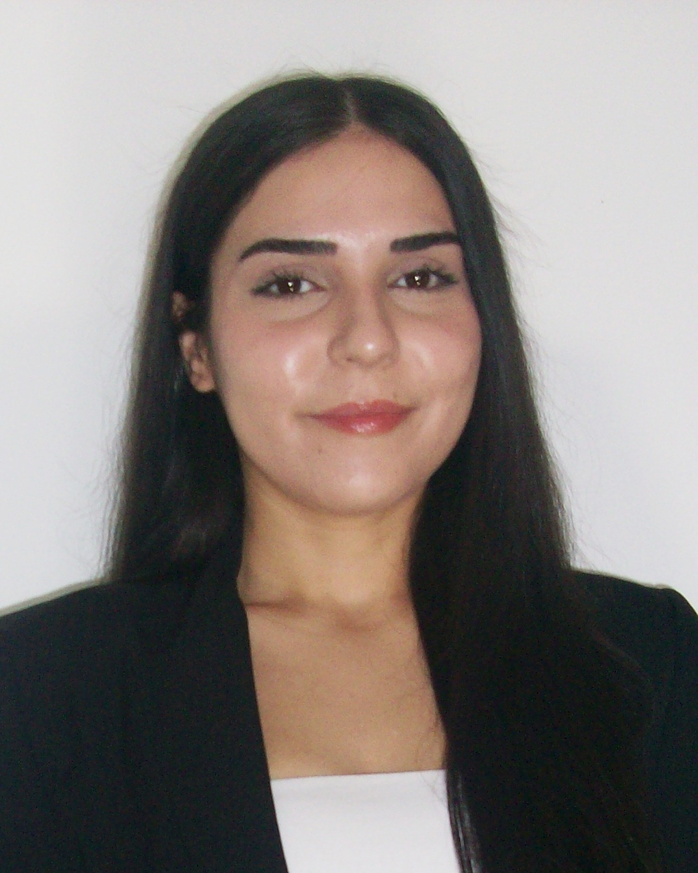
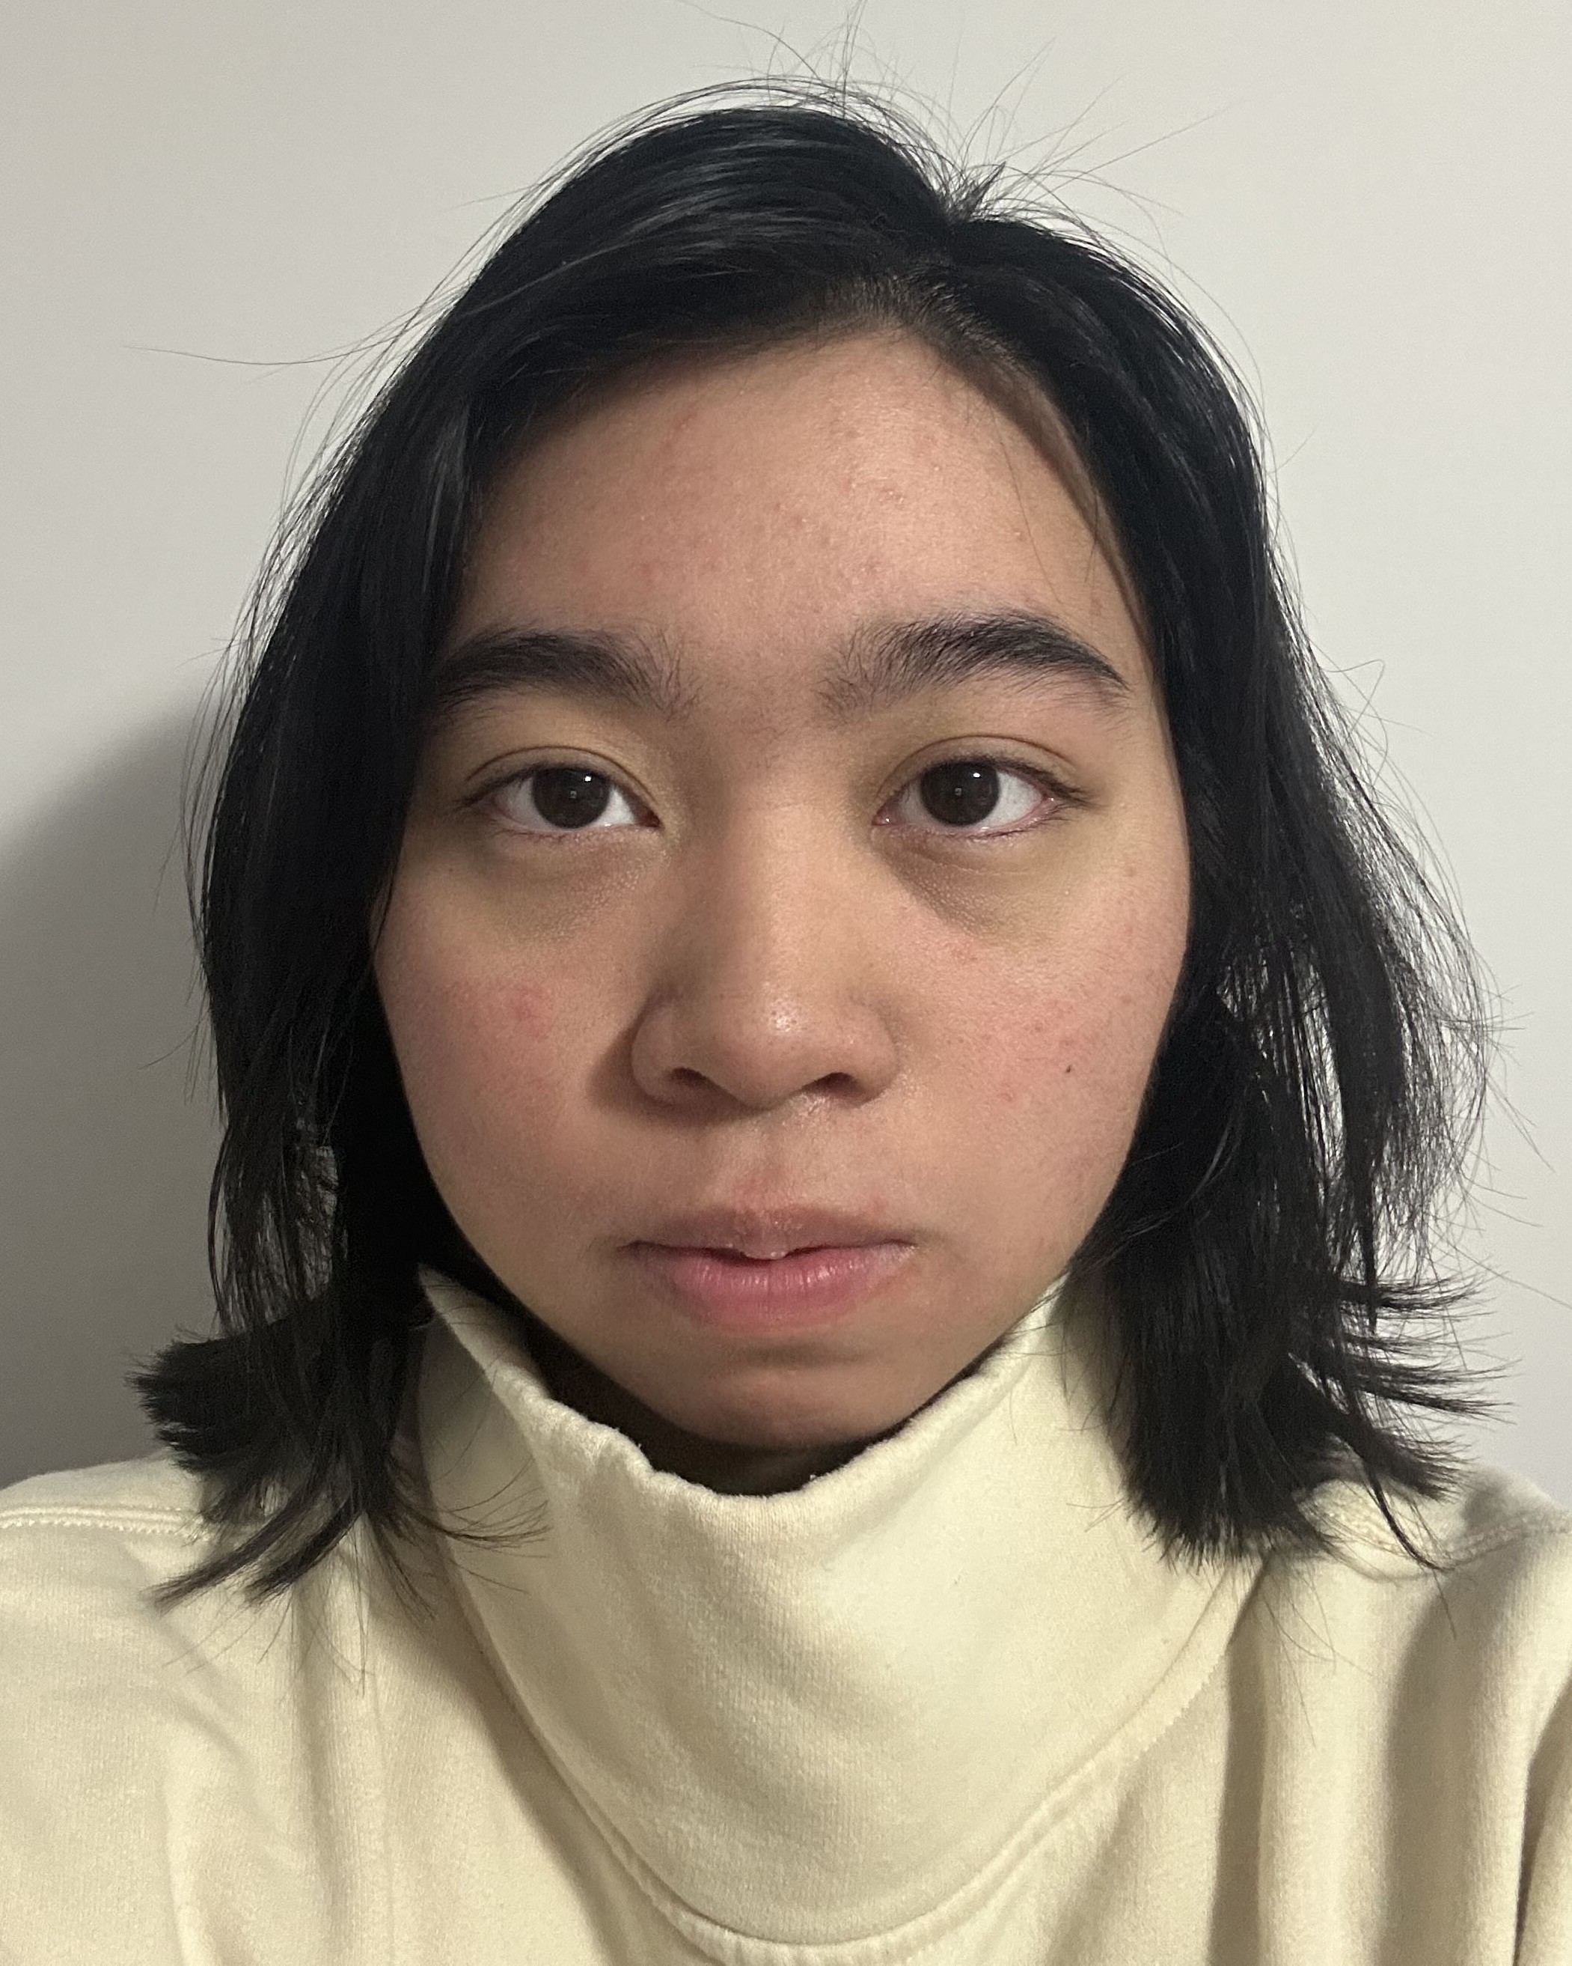





Sara Khoshaba
Lindsay Torres
Naz Serrano
Katie Yip
Sumaya Mohamed

